Slide 1
GST & VAT Revenue Apr to July
S.No. | Month | GST Net Revenue
 |  | FY 2025-26 | FY 2026-27 | Growth %
1 | April | (4646) 3,662 | 4,749 | (2.20%) 29.69%
2 | May | 3,491 | (3819) 3,280 | (9.39%) -6.04%*
3 | June | 3,453 | 3,615 | 4.68%
4 | July | 3,810 | 4,120 | 8.14%
Up to July |  | 14,416 | 15,764 | 9.35%
S.No. | Month | VAT Net Revenue
 |  | FY 2025-26 | FY 2026-27 | Growth %
1 | April | 1,795 | 2,008 | 11.85%
2 | May | 2,227 | 2,465 | 10.70%
3 | June | 2,215 | 2,487 | 12.30%
4 | July | 1,935 | 2,278 | 17.73%
Up to July |  | 8,172 | 9,238 | 13.04%
*538 Cr was deducted in the May’26, due to which growth has dropped to -6.04%, whereas it is actually 9.38%. Reasons being ascertained by TRU.

Slide 2
Revenue & Turnover Analysis Apr to July (2025 vs 2026)
Sector | Turnover (Apr-July'25) | Turnover (Apr-July'26) | Buoyancy % | Total Liability (I+C+S)'25 | Total Liability (I+C+S)'26 | Change % | Net Revenue to State'25 | Net Revenue to State’26 | Change %
All Sectors | 6,74,833.62 | 8,08,749.38 | 20% | 72,784.54 | 72,414.79 | -1% | 14,416 | 15,764 | +9.35%
Rate reduced after GST2.0
Vehicle/Automobile & Spare Parts | 31,834.99 | 37,641.53 | 18% | 7,830.42 | 6,431.08 | -18% | 1,994.50 | 1,966.20 | -1%
Electrical machinery and equipment | 45,314.41 | 58,666.66 | 29% | 7,377.23 | 7,275.19 | -1% | 1,561.26 | 1,474.01 | -6%
Machinery & Air Conditioning | 21,609.34 | 25,338.81 | 17% | 4,207.40 | 4,230.17 | 1% | 860.92 | 832.22 | -3%
Financial & Banking Services | 45,281.19 | 50,431.84 | 11% | 2,024.03 | 1,917.20 | -5% | 621.35 | 680.21 | 9%
Construction/Real Estate/ Cement | 59,583.98 | 58,993.72 | -1% | 11,025.37 | 9,248.03 | -16% | 1,844.03 | 1,426.45 | -23%
No Change in Rates
Iron and steel | 26,827.71 | 28,701.26 | 7% | 4,683.63 | 5,024.54 | 7% | 906.57 | 968.93 | 7%
Plastics and articles thereof | 11,913.42 | 15,408.86 | 29% | 2,093.29 | 2,552.13 | 22% | 411.41 | 480.29 | 17%
Support services | 7,207.77 | 7,891.62 | 9% | 1091.3564 | 1184.60 | 9% | 392.59 | 425.88 | 8%
Articles of iron or steel | 6,145.57 | 8,553.79 | 39% | 1068.3116 | 1,460.64 | 37% | 281.38 | 364.61 | 30%
Rate Increased after 2.0
Fuel and Energy | 70,648.26 | 75,859.98 | 7% | 1,552.62 | 1,701.55 | 10% | 760.20 | 1078.48 | 42%

Slide 3
Key Observations – Impact of GST 2.0 on Revenue (Apr–Jul 2026)
GST 2.0 reduced the average effective tax rate from 9.15% to 8.22%,
yet Rajasthan achieved 9.35% growth in Net Revenue through strong turnover growth and improved compliance.
1
UNDERSTANDING THE IMPACT OF GST 2.0
AVERAGE EFFECTIVE TAX RATE
GST 2.0 resulted in a substantial reduction in the average effective tax rate across sectors.
Yet, Rajasthan's Net Revenue increased by 9.35%.
FY 2025–26
(Apr–Jul)
9.15%
FY 2026–27
(Apr–Jul)
8.22%
→
Several major sectors witnessed GST rate reduction (28% → 18%, 12% → 5%).
Therefore, a lower overall tax liability was expected despite higher turnover.
This clearly indicates that the increase in economic activity and improved compliance has more than compensated for the reduction in tax rates.
Reduction of ~11% in average effective tax rate
2
OVERALL REVENUE SUMMARY (APR–JUL)
TURNOVER
TOTAL TAX LIABILITY
NET REVENUE TO STATE
₹6.75 Lakh Cr
₹72,785 Cr
₹14,416 Cr
(Apr–Jul 2025)
(Apr–Jul 2025)
(Apr–Jul 2025)
▼
▼
▼
₹8.09 Lakh Cr
₹72,415 Cr
₹15,764 Cr
(Apr–Jul 2026)
(Apr–Jul 2026)
(Apr–Jul 2026)
+20%
-1%
+9.35%
3
KEY TAKEAWAYS
Despite the significant reduction in average effective tax rate from 9.15% to 8.22% due to GST 2.0, strong compliance, effective tax administration and robust collections have enabled Rajasthan's Net Revenue to grow by 9.35% during Apr–Jul 2026.

Slide 4
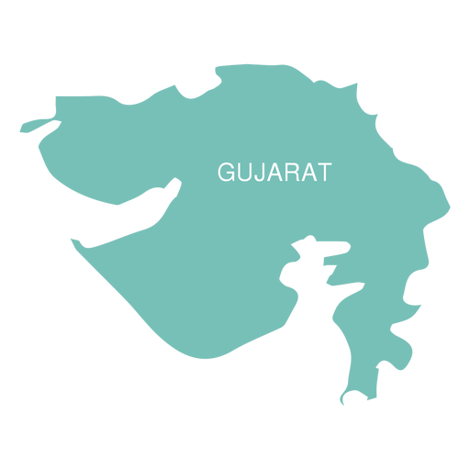
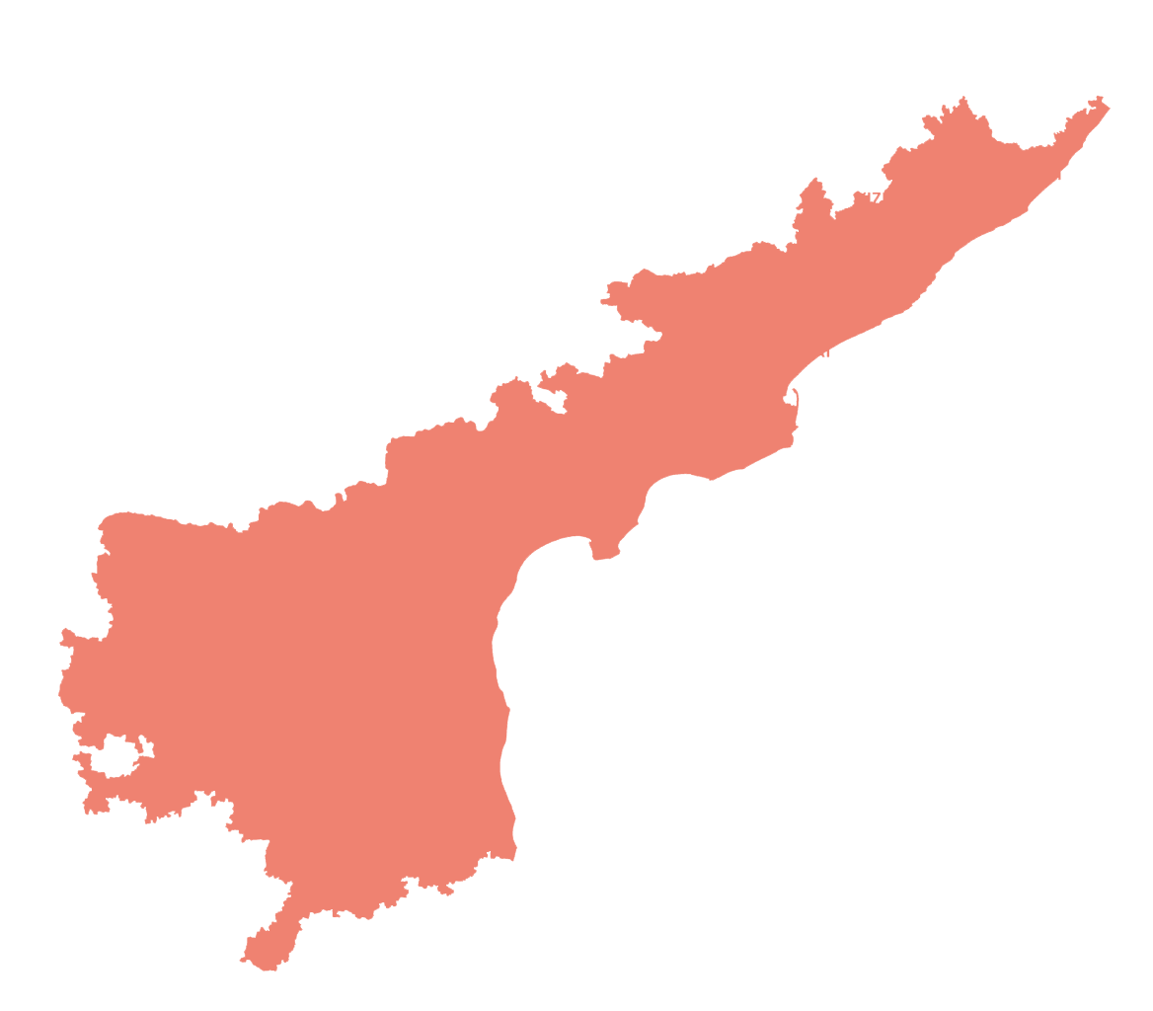
STUDY VISIT LEARNINGS
Directions of HCM Review
9th July 2026
DIRECTIONS
01
Visit & study best practices from AP & Gujarat.
02
Prepare an action plan for their phase-wise implementation.
PROGRESS
Visit to Andhra Pradesh planned for 4th & 5th August 2026.
Learnings from Gujarat - Detailed takeaways from the Gujarat study visit are consolidated on the following two slides
Andhra Pradesh
06 / 38
Notes:
Directions of HCM review, 9th July 2026: study best practices from AP and Gujarat.

Slide 5


Key Takeaways for Adaptation in Rajasthan
Practices observed during the study visit — review & revision and audit planning
01
System of Review & Revision
02
Audit Planning & Case Selection
Dedicated Review Branch at head office
Risk-based selection & Targets— orders dropping high-value Show Cause Notices, substantial refund orders, registration cancellations and cases of wilful misstatement or fraud
Targets fixed for each division: 85 cases per month and 1020 cases per year
Use of AI-Models to ascertain quality of appellate orders and assist in decision regarding further appeal
Centralized audit selection committee to finalize the annual audit plan
High-risk taxpayers profiled and taken up based on multiple risk parameters
Sector-focused, thematic and emerging-risk audits, with repeat audit where prior-year recovery was substantial and risk parameters persist
Outcome uniform, quality orders · reduced litigation · timely appeal and revision of orders affecting Govt. revenue
Outcome higher recovery per audit and better deployment of limited officer strength

Slide 6


Key Takeaways for Adaptation in Rajasthan
Practices observed during the study visit — registration control and risk-based identification
03
Registration Control & Bank account verification
04
Enforcement
PAN-based search at the time of registration to minimize already-cancelled firms obtaining fresh registration
Close monitoring of every new registration during the first 6 months of operation to prevent misuse of ITC
Continuous non-filer monitoring, with identification of dormant and suspicious taxpayers for follow-up action
Single risk profile for each taxpayer built from returns, e-way bill movement, registration history and third-party data
Early-bird predictive detection on e-way bill data — commodity wise, location wise analysis of supply and purchase (for example, consignments originating from North-Eastern States)
Secret contingency fund provided every year for raid, checking and field operations, and developing own intelligence
Outcome preventive control at source — bogus firms stopped before ITC leakage begins
Outcome Preventing establishment of fake firm networks and targeted enforcement actions

Slide 7
Enforcement
DIRECTIONS
DIRECTIONS
- Take state-wide action against ITC fraud and fake networks.
- Use intelligence-based decoy operations in high-risk sectors.
- Sector-wise calendar based on festivals etc., for anti-evasion action.
Progress
Particulars | Completed FY25–26 | Up to June’26 | July’26 | FY 26-27 Overall
No. of cases | 638 | 221 | 121 | 312
Revenue Detected | - | 310 Cr. | 216 Cr. | 526 Cr.
Voluntary Payments | 459 Cr | 185.38 Cr | 59.16 Cr | 244.54 Cr
Notes:
Enforcement directions and progress on anti-evasion activities, FY2026-27.

Slide 8
Decoy Operations in July 2026
Parameter | Details
Sector Covered | Coaching Institutes
Operations Conducted | 8 decoy operations across multiple districts of Rajasthan Parth Career Institute, Sikar Prayas Coaching Institute, Sikar
Modus Operandi Identified | • Suppression of taxable turnover by Non-issuance of tax invoices and Cash collections kept outside GST records • Incorrect / Excess ITC claim
Revenue Identified | ₹ 9.2 Crore
Voluntary Tax Payment | ₹ 1.4 Crore
Current Status | Investigations initiated and further verification in progress

Slide 9
Decoy Operations in July 2026
Parameter | Details
Sector Covered | Retail shops
Operations Conducted | Baba Thakur Das & Sons (Sweets Shop)
Modus Operandi Identified | The case was detected by departmental officers when it was found that the dealer was making outward supplies without issuing invoices and collecting payments through UPI/QR codes linked to personal and employees' bank accounts. The search was conducted on 21 July 2026. 15 QR codes were identified. Transaction details for only 2 QR codes have been submitted by the dealer so far. 3 firms of the same dealer were identified, out of which two are registered under the Composition Scheme.
Revenue Identified | ₹ 2 Crore detected so far (13 QR Codes more to analyzed)
Voluntary Tax Payment | -
Current Status | Investigations initiated and further verification in progress

Slide 10
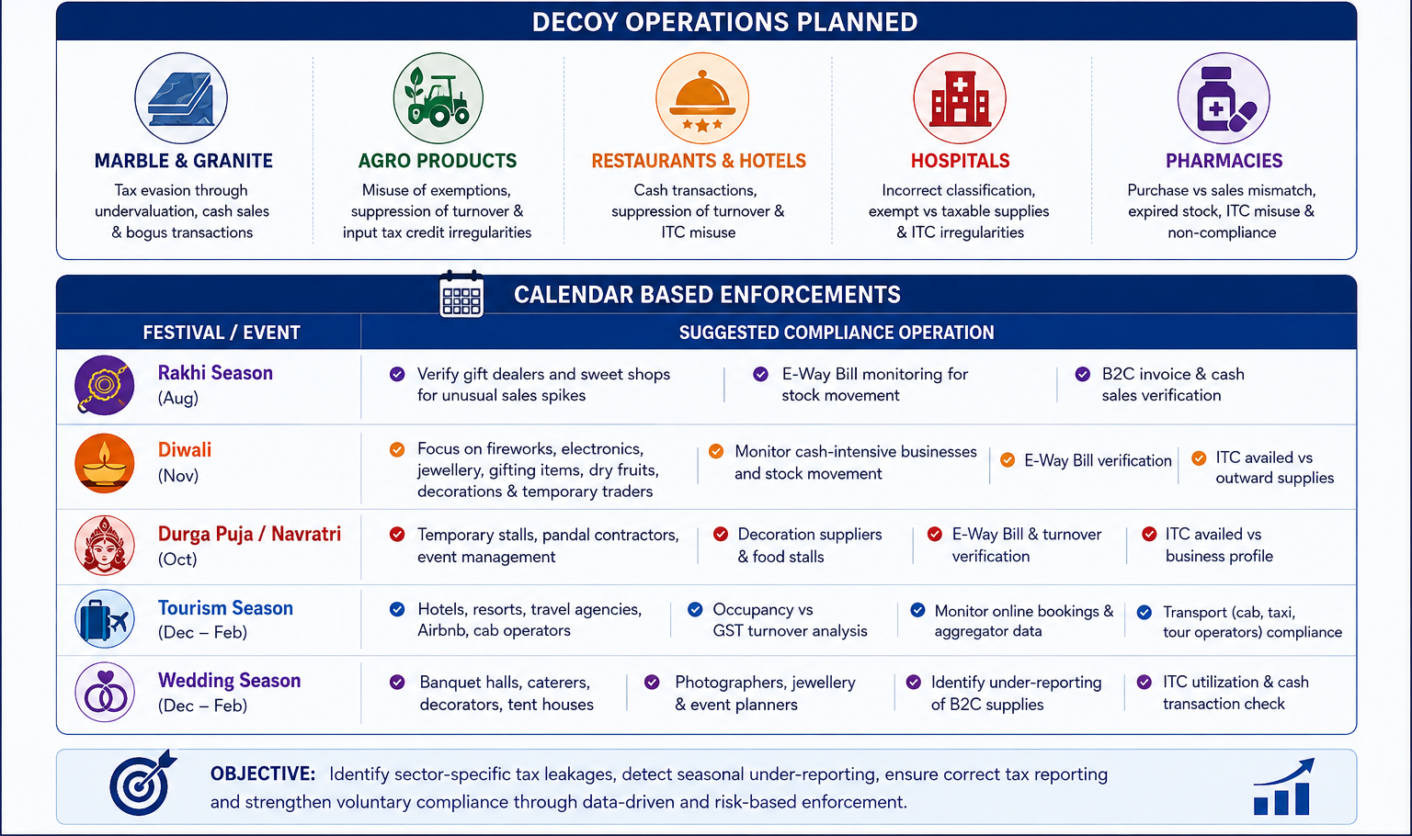
Further plans in FY 2026-27

Slide 11
Inter-Departmental Data & AI Analytics
DIRECTIONS
Identify tax evasion using inter-departmental data sources.
Identify tax evasion using AI & risk-based analytics.
Particulars | Status
No. of Depts from whom data is received | 5
No. of Depts from whom data is requested | 5
No. of use cases developed | 8
Revenue Potential detected | Approx. 100 Cr.

Slide 12
Inter-departmental data sources
#. | Dept | Departmental Data Taken | Use Cases based on data | No. of Cases & Revenue potential | Integration Status
1 | Electricity (DISCOM) | Electricity Consumption Data for 1 year | High Turnover low Consumption Low Turnover High Consumption Domestic Connection but High Turnover | 238 Cases | Complete
2. | IGRS | Joint Development Agreement, Rent Agreements | 1. Rent Agreement vs GST RCM Paid | 124 Cases; Potential: 18 Cr. | Complete
3 | Mining | eRwanna, Transit Pass, ERCC contracts | 1. ERCC royalty discrepancy 2. Royalty paid vs RCM paid in GST | 3198 Cases; Potential: 50 Cr. | Data Dump Received; Use Cases Developed
4 | RERA | Property sold, Project detail | 1. Units Sold vs GST Turnover | 271 Cases; Potential: 30 Cr. | Data Dump Received; Use Cases Developed
5 | RGHS | Payments and Invoices details for Hospitals and Pharmacies | Cancelled Taxpayer Invoices Turnover Mismatch | 238 Cases; Potential: 30 Cr. | Sample Data Received; Use Cases Developed

Slide 13
Example: Health Care Sector (RGHS vs GST Data Analysis)
As per the preliminary analysis of Pharmacy and Hospitals data shared by RGHS, 2 major use cases have been detected on comparing the GST Returns data with the invoice data:
1
USE CASE 1
2
USE CASE 2
Cancelled GSTIN, invoices Still Issued
Suppression of turnover
GST registration cancelled, yet RGHS continued deducting TDS against the same GSTIN.
Amount deducted by RGHS is more than the total turnover shown in GST returns.
TAXPAYERS
MISMATCH
TAXPAYERS
MISMATCH
13
₹1.30 Cr
225
₹29.14 Cr
TOTAL ACROSS ALL USE CASES
238
Total Turnover Mismatch
₹30.44 Cr

Slide 14
Inter-departmental data sources
#. | Dept | Integration Task | Current Status | Integration Status
1 | Transport | Vehicle Owner Detail (Vehicle Registration Data) | API requested from MoRTH and Transport Dept.. | In Progress
2. | JDA | Invoice wise detail of payment done against the contracts | Sample Data Shared by JDA, API is being developed at their end. | In Progress
3 | IFMS | Invoice wise detail of payment done against the vendors | Discussion done. API is being developed at their end. | In Progress
4 | Railways | Weight of Goods, Value of Goods etc. | Data feasibility study under progress. | In Progress
5 | UDH | Auction processing fees, Lease of land , Sales of commercial plots , Licensing fees | Data feasibility study under progress. | In Progress

Slide 15
AI – ML & Risk Based Analytics
1
USE CASE 1
2
USE CASE 2
3
USE CASE 3
New Registration High Inter-State Sales
Non-Filers more than 6 months
Electricity Consumption Compared with GST Turnover
Newly registered taxpayers having inter-state sales and tax paid entirely using ITC
Taxpayers who have not filed return for than 6 month, either made to file returns or suspended / cancelled if found inexistent / non-genuine.
The electricity bill of the taxpayers were read using OCR and electricity consumption was compared with the Turnover of the Manufacturer Taxpayers
TAXPAYERS
Amount Involved
TAXPAYERS
Cancelled / suspended
TAXPAYERS
Domestic Connection but Turnover>10 Cr
51
₹296 Cr
2950
436
238
215

Slide 16
AI – ML & Risk Based Analytics
4
5
USE CASE 5
6
USE CASE 6
USE CASE 4
Taxpayers having Bank Accounts involved in Cyber Frauds
Same Bank Account used by multiple GSTINs which was cancelled previously
Active Registration in Rajasthan but rejected in other states
The Bank Accounts provided in the GST Registration was compared with Bank Accounts involved in Cyber Fraud
Same bank account linked to multiple taxpayers. Out of these taxpayers more than 50% are cancelled.
Taxpayer’s whose registration application was rejected / Cancelled in other states but is doing business in Rajasthan
TAXPAYERS
Cancelled / suspended
TAXPAYERS
Cancelled / suspended
TAXPAYERS
356
30
3474
159
1607
238

Slide 17
AI – ML & Risk Based Analytics
7
8
USE CASE 8
9
USE CASE 9
USE CASE 7
NIL Filers for more than 12 months
GST welcome letter not delivered
OCR Based reading of documents
Taxpayers filing Nil returns regularly which means no active business, but may be sleeping cells which may pass on fake ITC in upcoming returns
Welcome Letters are sent by GSTNto all newly registered taxpayers to ensure the place of business. Returned welcome letter may lead to suspicious taxpayers
Extraction and analysis of data from GSTR-9, Profit & Loss Statements, Balance Sheets etc. using OCR and comparison with GST Database.
Eg. Legal fees paid as per P&L but RCM not paid in GST
TAXPAYERS
Taxpayer suspended
TAXPAYERS
Taxpayer suspended
1.02L
27274
20730
1267
Work in Progress

Slide 18
Fake Firm Detection & Cleaning the Taxpayer Base
FAKE FIRM DETECTION
CLEANING THE TAXPAYER BASE
Particulars | FY25–26 | FY26-27
Fake Firms Detected | 330+ | 63
ITC Involved (₹ Cr) | 668.41 | 259.71
Suspicious Firms (Repeat Offenders) | - | 2675
Registration Cancelled (Improper Docs / Field Visit) | - | 3752
Particulars | FY25–26 | FY26-27
Potentially Suspicious Taxpayers from Nil Payers | - | 27274*
Returned Welcome Letters |  | 1267
FY25–26
Particulars
FY25–26
FY26–27
*Identified through nil-filing pattern analysis; further field verification in progress.
STATE TAX DEPT. · GOVT OF RAJASTHAN
DATA-DRIVEN DETECTION & AI
19 / 38
Notes:
Fake firm detection and revenue from intelligence reports; cleaning the taxpayer base.

Slide 19
Tax Administration Performance Index Source : GST Analytics and Intelligence Network portal - GSTN
Composite score across 16 GST administration parameters, by state (Published Quarterly)
State Rankings — Total Score (0–100)
PAN INDIA avg: 52.4

Slide 20
Revenue Growth: Month-wise Forecasting Snapshot
FY 2026–27 ( ₹ in Crore )
Month | FY-26-27 | Growth
Apr | 4,749 | 2.21%
May | 3,280 | -6.39%
Jun | 3,615 | 4.68%
Jul | 4,120 | 8.15%
Aug | 3,865 | 8.10%
Sep | 3,735 | 8.95%
Oct | 4,695 | 12.81%
Nov | 4,395 | 13.04%
Dec | 3,851 | 13.46%
Jan | 4,590 | 14.61%
Feb | 4,134 | 10.56%
Mar | 4,985 | 12.12%
Total | 50,014 | 8.61%
Aug 26 – Mar’ 27 figures are model-based forecasts – XGBoost, Time Series, Arima
Full-year GST net revenue is projected to grow by 8.61 %, increasing from ₹46,050 Cr (FY25–26) to ₹ 50014 Cr (FY26–27).

Slide 21
Meeting with Secretary Revenue, GOI
Meeting with Secretary Revenue, GOI
Point 1 : The note mentions that Rajasthan's B2C ratio is approximately 7, against a normal benchmark ratio of 4.5.
GSTN was requested for complete data and methodology. GSTN report is as given below:
ALL INDIA (in 1 Lakh Crore)
FY | B2C Supply | Domestic Supply | B2C%
2017-2018 | 32.03 | 168.32 | 19.03%
2018-2019 | 48.64 | 260.85 | 18.65%
2019-2020 | 49.57 | 261.52 | 18.95%
2020-2021 | 46.77 | 261.06 | 17.91%
2021-2022 | 58.34 | 344.33 | 16.94%
2022-2023 | 69.44 | 407.16 | 17.06%
2023-2024 | 76.38 | 444.22 | 17.19%
2024-2025 | 82.65 | 495.14 | 16.69%
2025-2026 | 91.56 | 567.44 | 16.14%
Grand Total | 555.39 | 3210.03 | 17.30%
Ratio |  |  | 5.78
RAJASTHAN (in 1 Lakh Crore)
FY | B2C Supply | Domestic Supply | B2C%
2017-2018 | 1.30 | 6.84 | 19.00%
2018-2019 | 1.96 | 10.53 | 18.59%
2019-2020 | 2.00 | 10.52 | 19.04%
2020-2021 | 1.97 | 10.86 | 18.16%
2021-2022 | 2.51 | 14.42 | 17.38%
2022-2023 | 2.94 | 16.84 | 17.49%
2023-2024 | 3.22 | 18.11 | 17.80%
2024-2025 | 3.48 | 19.96 | 17.42%
2025-2026 | 3.85 | 22.51 | 17.10%
Grand Total | 23.23 | 130.58 | 17.79%
Ratio |  |  | 5.62
Conclusion — Based on the data provided by GSTN, no significant difference is observed between Rajasthan’s B2C ratio (5.62) and the all-India ratio (5.78).

Slide 22
Meeting with Secretary Revenue, GOI
Point 2:
An anomaly-detection technique identified approximately 5.37 lakh taxpayers who paid lower tax compared to their respective peer band. Of these, approximately 1.22 lakh taxpayers paid only ₹194 crore through the cash ledger.
5.37L
1.22L
₹194 Cr
Flagged taxpayers
Low cash-ledger payers
Cash-ledger payment
CURRENT STATUS
GSTN not able to provide any information related to the above anomaly.
DoR has been requested for further classification and necessary details.
1.
SECRETARY REVENUE · CLARIFICATIONS
2.
28 / 38
Notes:
Point 2: anomaly-detected taxpayers paying lower tax vs peer band; current status.

Slide 23
Other Departmental Progress: Scrutiny, Recovery & Audit
Particulars | FY25-26 | FY26-27
Cases Taken Up for Scrutiny | 25,225 | 34,401
Revenue Recovery (Overall), Cr. | 129.91 | 150.25
Audit | FY25-26 |  | FY26-27
 | Cases Disposed | Revenue Realised | Cases Disposed | Revenue Realised
April | 54 | 2.76 | 153 | 5.67
May | 176 | 6.10 | 244 | 9.03
June | 179 | 7.44 | 267 | 7.98
July | 119 | 5.58 | 145 | 13.81
Total | 528 | 21.87 | 809 | 36.49
Cases selected based on high-risk parameters and large taxpayers (above ₹10 Cr).
DETECTION, SCRUTINY, AUDIT & LITIGATION
34 / 38
Notes:
Scrutiny and recovery directions and progress, including faceless scrutiny implementation.

Slide 24
Litigations
NCLT
PERMISSION FOR PANEL LAWYERS RECEIVED FOR -
Forum — Permission Pending
Pending Cases
PERMISSION FOR PANEL LAWYERS PENDING FOR:
Revenue Board
GSTAT
NCLAT
CSTAA
CESTAT
Rajasthan High Court – Single Bench
Supreme Court
421
Rajasthan High Court — Jodhpur (Principal Seat)
535
Rajasthan High Court — Jaipur Bench
1,609
RCSAT Court
19
Other State High Courts
5
Economic Offences Court
23
Tax Board & Revenue Board
330
1ST APPELLATE AUTHORITIES
GSTAT
182
10
Additional Commissioners handling cases with the 1st Appellate Authorities – 15359
NCLT + NCLAT + CSTAA + CESTAT + Others
74
Total
3,195
37 / 38
Notes:
Litigation status: panel lawyer permissions and cases pending across forums.

